Slide 1
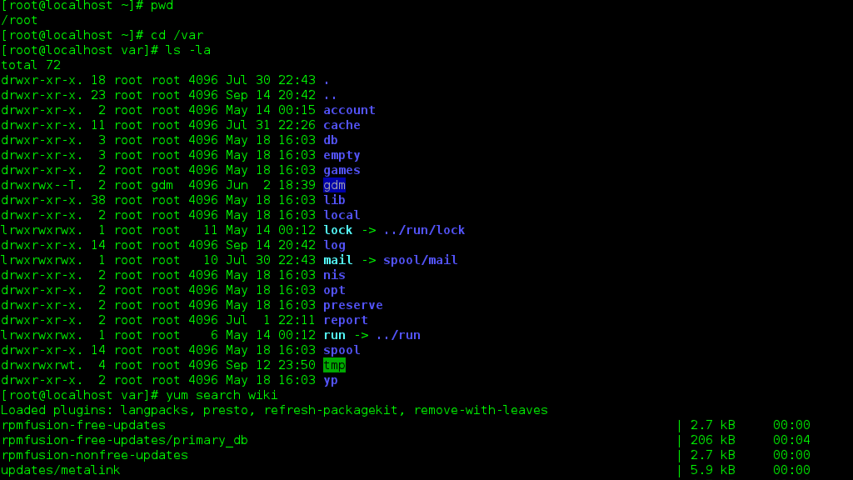
Chapter 3
C’mon – is it ever gonna end?

Slide 2
Commands
du (display used disk space) df (display free disk space) file (display type of file) gzip, bzip2 (compress/uncompress files) kill (terminate a process) nl (line numbers) ps (process list) sort (sort a file) tar (create archive file) top (view processes in real time) wc (word count)

Slide 3
File Types
-rw-r--r--. 1 root root 49919 Jun 4 2012 install.log drwxr-xr-x. 24 root root 4096 Jan 29 09:19 home crw--w----. 1 root tty 4,0 Jan 17 03:44 tty0 brw-rw----. 1 root disk 8,1 Jan 17 08:44 sda1 lrwxrwxrwx. 1 root root 3 Jan 17 08:44 dvd -> sr0 brw-rw----+ 1 root cdrom 11,0 Jan 17 08:44 sr0
Using the file command will give more exact information about the type of file

Slide 4
file
Determines the type of file given the filename
$ sudo file /scripts/assignment02.sh assignment02.sh: Bourne-Again shell script, ASCII text executable
$ sudo file /scripts/hello-2.8.tar.gz /scripts/hello-2.8.tar.gz: gzip compressed data, max compression, from Unix

Slide 5
Compressing Files
Command | Explanation | Example
gzip filename | Gzip compresses the size of files using Lempel-Ziv encoding. Each file is replaced by one with the extension .gz | gzip mydata.doc gzip *.jpg
bzip2 filename | bzip2 compresses files using the Burrows-Wheeler block sorting text compression algorithm, and Huffman encoding. Each file is replaced by one with the extension .bz2. | bzip2 mydata.doc bzip2 *.jpg

Slide 6
Creating tarballs
tar -czvf tarball.tar.gz /path/to/files tar -cjvf tarball.tar.bz2 /path/to files
-c – create -j – use bzip2 compression -z – use gzip compression -v – verbose -f – filename
$ sudo tar –czvf ~/work.tar.gz /scripts/work

Slide 7
Decompressing Files
Command | Explanation | Example
gzip -d filename.gz gunzip filename.gz | Decompress a file that was created using gzip. File is restored to its original format. | gzip -d mydata.doc.gz gunzip mydata.doc.gz
bzip2 -d filename.bz2 bunzip2 filename.bz2 | Decompress a file that was created using bzip2. File is restored to its original format. | bzip2 -d mydata.doc.bz2 bunzip2 mydata.doc.bz2

Slide 8
Extracting tarballs
tar –xzvf tarball.tar.gz –C /target/directory tar –xjvf tarball.tar.gz –C /target/directory
-x – extract -z – gzip archive -j – bzip2 archive -v – verbose -f – filename -C – full path to extract files to
$ sudo tar –xzvf ~/work.tar.gz (extracts at present working directory)
$ sudo tar –xzvf ~/work.tar.gz –C /home/dmc1209 (extracts to specified dir)

Slide 9
Disk Utilization (used space)
du [options] /path/to start
-h (human readable) -s (summarize) -a (show all) -c (show total at the end)
$ sudo du –hs /etc/ 5.7M /etc/

Slide 10
Disk Utilization (free space)
df [options] /dev/sdx
-h (human readable) -a (show all) -T (display filesystem type)
$ sudo df –haT /dev/sda1
Filesystem Type Size Used Avail Use% Mounted on /dev/sda1 ext4 9.7G 1.6G 8.1G 17% /

Slide 11
wc (word count)
wc [options] filename…
-c (print byte count) -m (print character count) -l (print line count) -L (print length of longest line) -w (print word count)
$ sudo wc /scripts/sample1.log 44 610 5852 /scripts/sample1.log
44 = number of lines 610 = number of words 5852 = number of characters

Slide 12
nl
nl [option] file…
-w (set number of columns for line numbers)
$sudo nl /scripts/list.txt 1 apples 2 oranges 3 potatoes 4 lemons 5 garlic

Slide 13
sort
sort [option] file…
-f (ignore case) -M (month sort ‘JAN’..’DEC’) -r (reverse) -u (print only unique lines)
$ sudo sort scripts/list.txt apples garlic lemons oranges potatoes

Slide 14
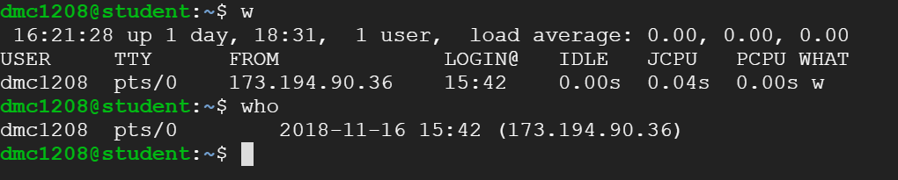
who / w

Slide 15
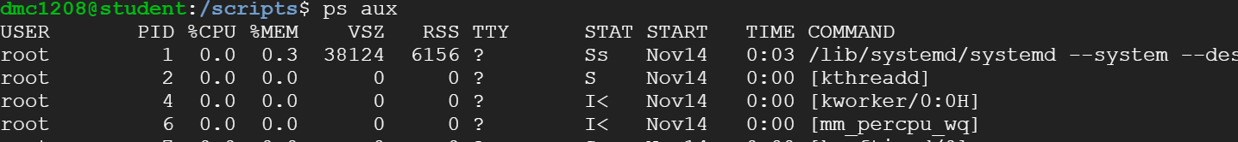
ps
ps [options]
-e (select all processes) -p pidlist (select all pids in list) -u userlist (select by username or userid)
aux (show user information and process information)

Slide 16
kill
The kill command sends a signal to a process.
By default the TERM (15) signal is sent, which terminates the process.
kill –signal pid
-signal (number of the signal to send) -l (list options) pid (process id of process to be killed
$ sudo kill -15 2734 $ sudo kill -9 2734

Slide 17
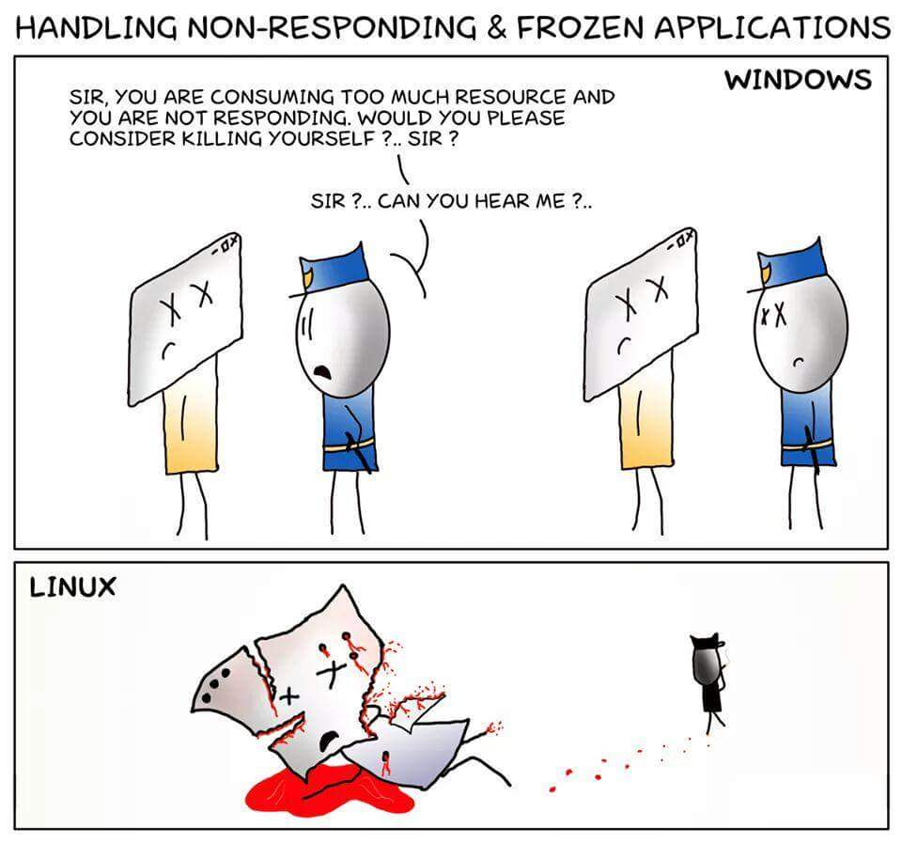
kill -9 [pid]

Slide 18
whereis
whereis [options] filename…
-b (search only for binaries) -m (search only for man pages) -s (search only for sources
$ whereis python python: /usr/bin/python3.5m /usr/bin/python2.7 /usr/bin/python3.5 /usr/bin/python /usr/lib/python2.7 /usr/lib/python3.5 /etc/python2.7 /etc/python3.5 /etc/python /usr/local/lib/python2.7 /usr/local/lib/python3.5 /usr/share/python /usr/share/man/man1/python.1.gz
$ whereis –m python python: /usr/share/man/man1/python.1.gz

Slide 19
which
which –a filename…
-a (print all matching pathnames of each matching filename)
$ which –a python /usr/bin/python
$ which –a python which /usr/bin/python /usr/bin/which /bin/which

Slide 20
man
man page…
man is the system's manual viewer; it can be used to display manual pages,
Each argument given to man is normally the name of a program, utility or function.
$ man which
$ man kill

